Slide 1
Business Process Engineering
Sobia.Iftikhar@nu.edu.pk Week 01
GCR: nciamel BSE-6B
GCR: 55qb6ki BSE-6A

Slide 2
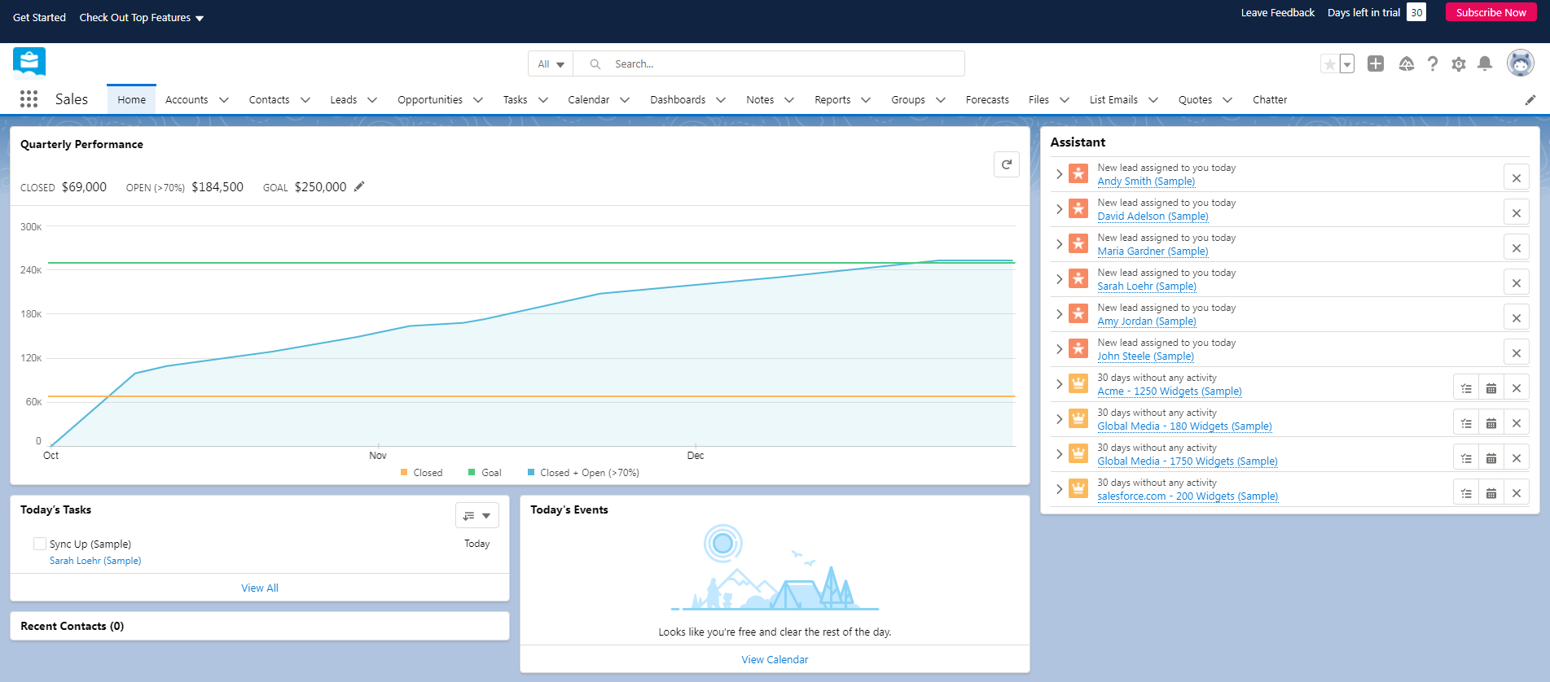
CRM
Salesforce is the world’s #1 customer relationship management (CRM) platform. We help your marketing, sales, commerce, service and IT teams work as one from anywhere — so you can keep your customers happy everywhere.
https://www.salesforce.com/ap/products/what-is-salesforce/

Slide 3
CRM
Customer Relationship Management or CRM consists of strategies, processes, and software that manages your company’s interactions with customers and potential clients.
CRM can be used in marketing, sales, and operations, to monitor and improve relationships, and upsell clients.

Slide 4
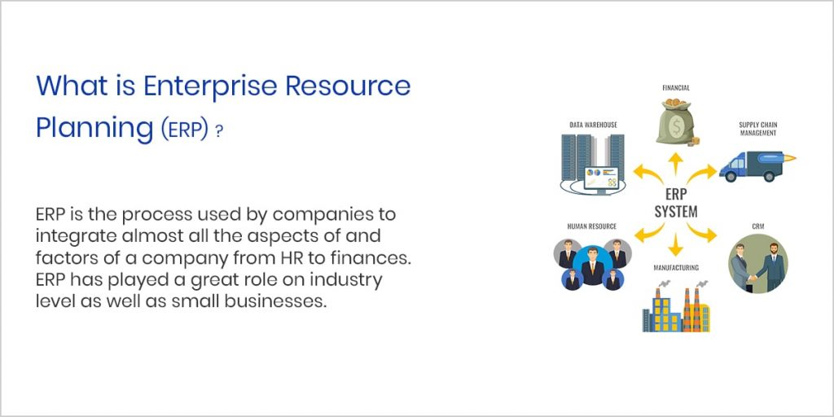
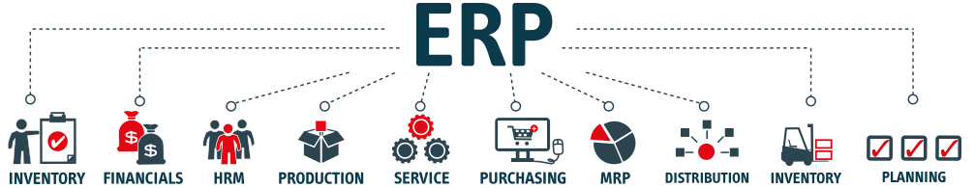
ERP

Slide 5
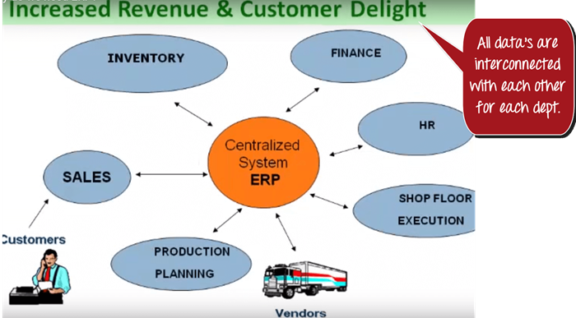
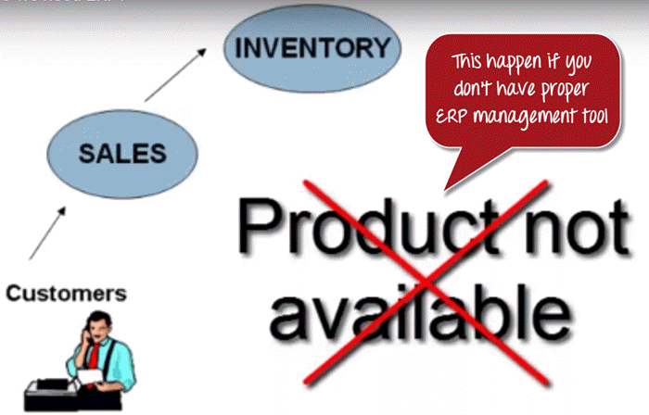
Example
Suppose a client approaches sales team asking for a particular product. The sales team contacts to inventory department to check the availability of the product. To their surprise, sales team found out that the product is out of stock

Slide 6
In many ERP systems, these common functional areas are grouped into ERP modules, including but not limited to:
Financial Accounting
Management Accounting
Human Resources
Manufacturing
Order Processing
Supply Chain Management
Project Management
Customer Relationship Management (CRM)
Data Services

Slide 7
What Is An ERP?
Enterprise Resource Planning (ERP) software systems are used by companies to oversee, customize and automate time-consuming daily activities.
This includes business needs such as:
Financial management
Human resources
Project management
Sales orders
Warehouse management
Supply chains
Sales volume
Risk management
Inventory management

Slide 8
How Does ERP Software Work?
Business operations can suffer when companies use multiple standalone systems to manage workflow. Toggling between multiple systems is time-consuming and breaks down workflow progress.
Enter ERP systems.
Using one common database, instead of separate standalone systems, allows multiple users to utilize the same information and get the job done.

Slide 9
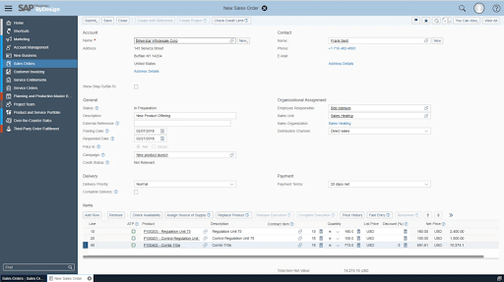
3 Real Examples of Large Companies Using ERP
1. Amazon
Amazon uses an ERP software called Systems Analysis and Program Development (SAP).
Financial accounting
Invoice verification
Inventory management
SAP S/4Hana Cloud is the most modern version of SAP ERP with built-in AI, machine learning, and advanced analytics.

Slide 10
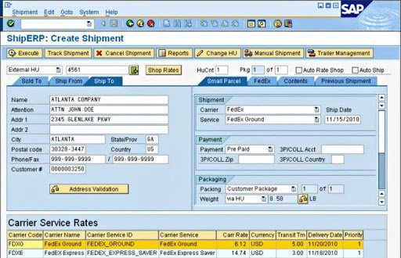
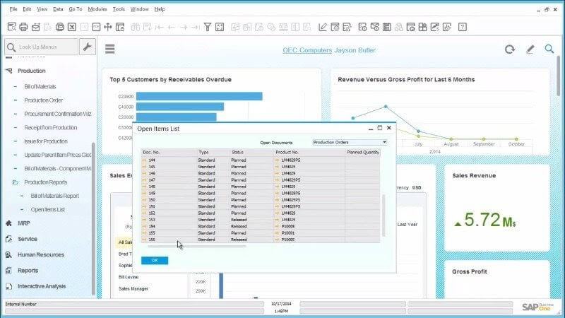
1.Amazon

Slide 11
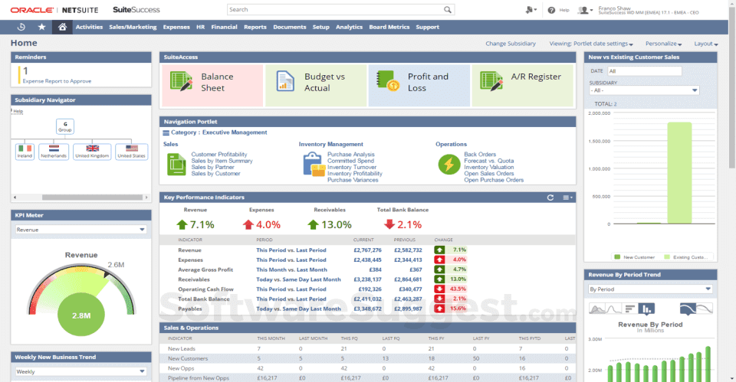
2. Starbucks
Starbucks uses Oracle ERP – a cloud-based software solution used to automate back-office processes and day-to-day business activities.

Slide 12
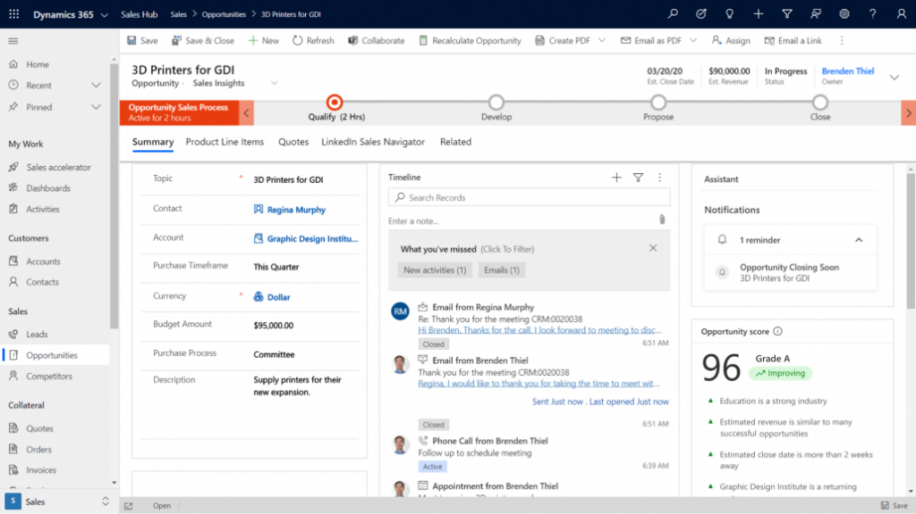
3. Toyota
Toyota chose Microsoft Dynamics 365

Slide 13
CRM VS ERP
What’s the difference?
ERP and CRM systems use different approaches to increase profitability. ERP focuses on reducing overheads and cutting costs. By making business processes more efficient, ERP reduces the amount of capital spent on those processes. CRM works to increase profits by producing greater sales volume.

Slide 14
Who should be involved in BPM?
‘Involved’, means includes such as process reviews, process modeling, process redesign various types of process management.
Processes are not a goal in themselves, as they are simply a means to achieve a business objective.
Processes will not achieve a business objective automatically or by chance; they need continuous and effective management
We would suggest that there are two aspects to operational management of business processes:
Management of business processes as an integral part of ‘management’
Management of business process improvement.

Slide 15
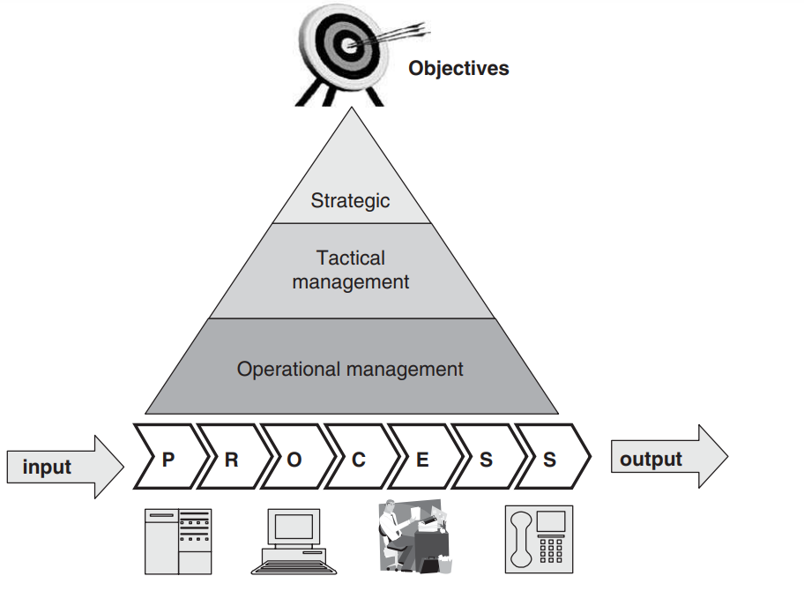
Management of business processes as an integral part of ‘management’
This type of management is responsible for the realization of the business objectives and organization strategy.
This management of business processes should be performed by line management.

Slide 16
Line Manager
These line-managers can be classified according to their main scope of activities:
Operational managers should be working with clearly defined processes and related objectives. Their main involvement in the processes are to adjust the resourcing of the people aspect of the process(es) (for example, more or less staff) and solve operational problems (for example, errors as a result of the processes).
Tactical managers will be looking at improvements of the processes.
Strategic managers will be looking at the business model and the related processes.

Slide 17
Process Ownership Responsibilities
specifying objectives (goals) and measures that relate to the objectives and targets to be achieved – these targets should be broken down into daily or weekly measures to enable continuous monitoring and management
communicating the objectives, measures and targets to the people executing the processes and, if necessary, providing rewards and incentives
monitoring and managing progress of the targets, and verifying whether the objectives and measures are still accurate and relevant
motivating staff to exceed objectives and deal with process disturbances
encouraging staff to identify bottlenecks and possible process improvements.

Slide 18
Management of business process improvement
These managers are responsible for supporting the business/organizational managers in improving their processes,
They should not be responsible for the day-to-day management of the business processes. We call these managers are BPM managers.
BPM project manager
BPM program manager
Business Process Excellence
Chief process officer
whose main responsibility is to ensure that the objectives of the BPM project, as outlined in the business case, are being met
To facilitate multiple BPM projects so they meet the program’s objective.
Business and processes are
aligned to ensure that the maximum benefits are obtained from the
business processes
processes and IT are aligned with the strategy

Slide 19
Why are organizational strategy and process architecture important in BPM implementation?
Organizational Strategy due to:
Sets Direction And Priorities
Aligns Teams And Departments In A Common Goal
Clarifies And Simplifies Decision Making
Allows Your Business To Adapt
Process Architecture
A good process architecture will ensure that more time and effort is saved by its use. It will also provide a means of communicating, specifying and agreeing the process objectives and principles in a way that it is clear for everyone. Where process architecture already exists, it will be much easier to identify the impact of the suggested changes against the agreed standard.

Slide 20
Organizational Strategy
An organizational strategy is an action plan for how a company will achieve its long-term goals.
Organizational strategy is a plan that specifies how your business will allocate the following resources :
Money
Labor
inventory

Slide 21
Organizational Strategy Categories
When you sit down to create your organizational strategy, you should first divide it into three distinct categories:
Corporate level strategy:
The Corporate Level is the highest level in any organization, so choices here will impact the main business goal.
Business leaders here identify the actions to take that will best position the organization to meet the marketplace’s needs
Business level strategy:
At the Business Level, managers identify how a company is going to react to a market and bring value to its customers.
Functional level strategy:
daily operations and ensuring they are aligned with the organization’s higher-level goals.

Slide 22
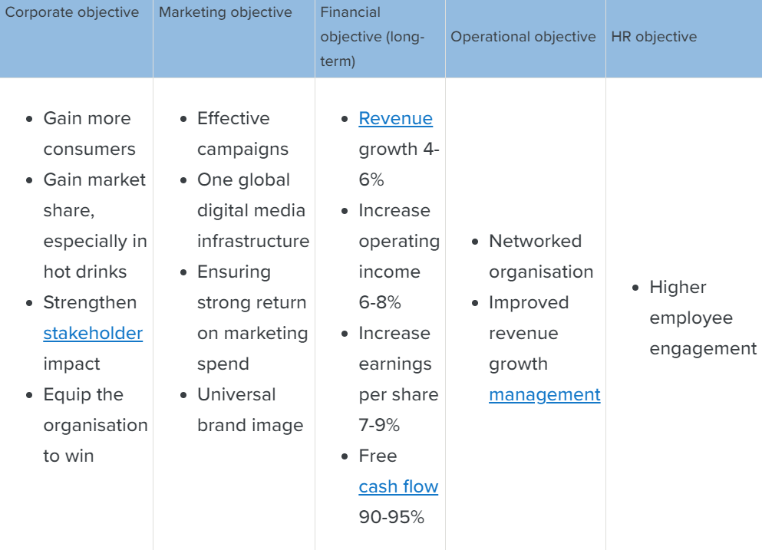
Example

Slide 23
Process Architecture
Process architecture is much more than a process model;
it also includes the objectives, principles, strategies and guidelines that are the foundation of the models.
A process model is just a snapshot of the current thinking, and does not provide sufficient guidance for reviewing existing or creating new processes.

Slide 24
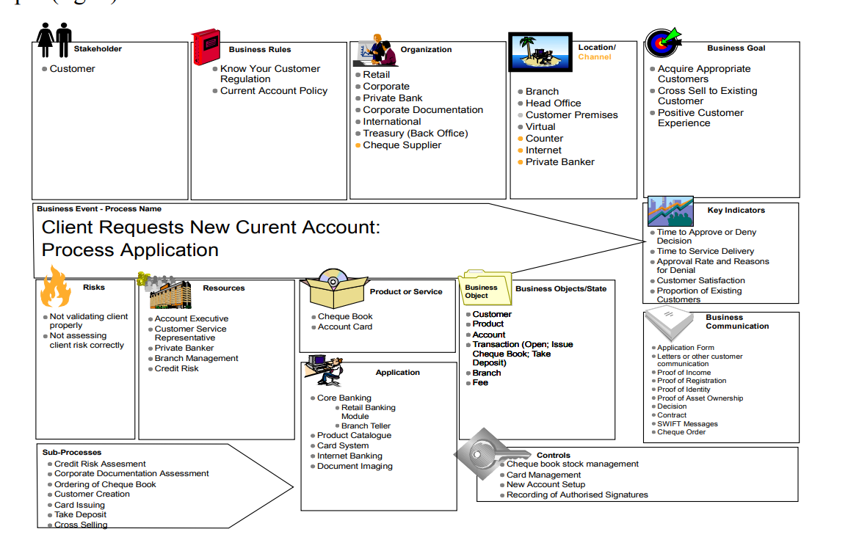
Process Architecture

Slide 25
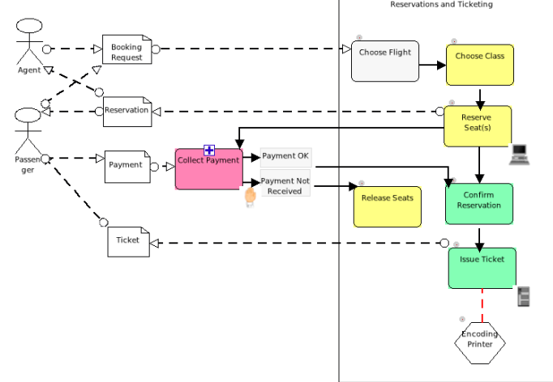
Process Model

Slide 26
How do you sell BPM technology to the organization?
The volume of work and the complexity of the business process demand that organizations look for possible IT applications to support and automate their processes.
– whether a telecom operator providing an ASDL connection, a bank processing a loan application, an insurance company handling a claim, or a local government organization processing a request for a new passport

Slide 27
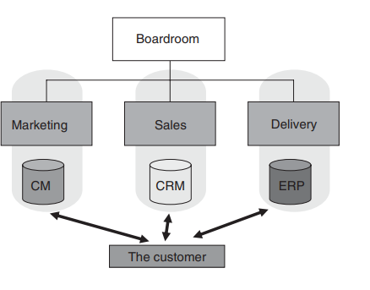
How do you sell BPM technology to the organization?
Throughout the years, many companies have invested millions in all sorts of IT solutions.
The marketing department has its Enterprise Content Management (ECM) system, used to inform the consumer of the organization’s products or services.
The sales department has a Customer Relation Management (CRM) system to allow the company to up- and cross-sell, and finally the delivery department has an Enterprise Resource Planning (ERP) system to process the order and send an invoice

Slide 28
Who is buying BPM technology?
As mentioned previously, both the business and the IT sides of an organization are involved in acquiring BPM technology.
business manager can buy an automated BPM solution. Generic arguments for any business manager include the following:
BPM technology provides business process transparency
the business becomes more agile

Slide 29
Case study: BPM automation in a telecommunications organization
A European telecommunications company was faced with an extremely fast-growing demand for broadband services, just as most countries in Europe.The company anticipated the challenge of such high demand, realizing that if it did not update its system for managing customer requests and broadband orders then business would suffer.The existing system was entirely manual, so every order had to be produced from one system and passed to another by its employees.About eighty processes were divided over twenty systems and ten departments. On average, one order took two days to process.This was proving to be very expensive and a waste of resources, especially since it was a relatively straightforward procedure. By implementing a BPM infrastructure, the company is now able to process approximately 80 percent of orders automatically, and turns around most orders within two hours, thus reducing the process time by 90 percent.This has also increased quality by reducing errors by 95 percent. A full return on investment was achieved within a year of implementation. On a practical level, the company has learned a lot more about its business and how it operates – ‘Now we actually know exactly how our customer order process works’. Using the previous legacy system, it took the company between four and six weeks to make any changes; now, any problems in the processes can be fixed in two weeks

Slide 30
OutCome
productivity is increased at a lower cost
compliance can be provided
customer service is improved.

Slide 31
When addressing an IT department, the following issues should be presented:
● with BPM technology, the earlier investment in IT applications will not be wasted
● BPM will link these independent applications together
● the IT department can be more responsive to the changing business requirements
● the new applications can be provided faster, cheaper and more flexibly

Slide 32
Who is selling BPM technology?
we can see the following three parties involved in selling an automated BPM solution:
Parties internal to the organization
A software vendor
A system integrator and/or consultant

Slide 33
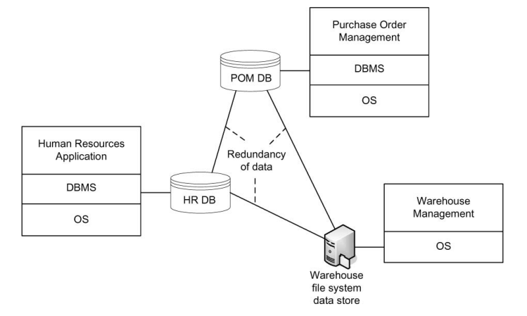
Enterprise Resource Planning Systems
An enterprise resource planning system stores its data in one centralized database, and a set of application modules provides the desired functionality, including human resources, financials, and manufacturing.
Enterprise applications with redundant data and data dependencies

Slide 34
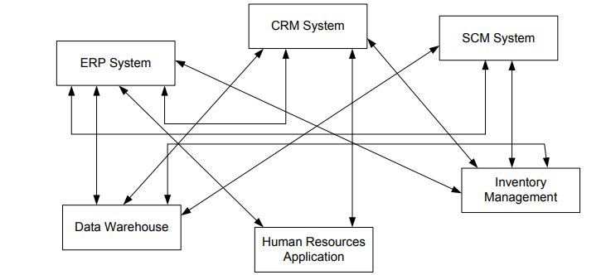
Enterprise Resource Planning Systems
Early enterprise application integration: hard-wiring of application systems results in N × N problem
any change in the application landscape needs to be

Slide 35
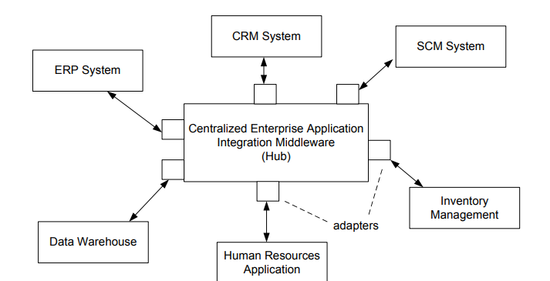
Hub-and-Spoke Integration

Slide 36
Value Chain
Developments in software architecture, business administration also contributed to the rise of business process management.
There were two major factors that fuelled workflow management and business process management.
Value Chain
process orientation

